Slide 1

Question 1
Organizing and Visualizing Data in R
Workshop
By Gabriel Kamener FCE Information Manager, Florida International University
2024 Florida Coastal Everglades Information Management
Information Management
Mar 14, 2024

Slide 2
Today’s workshop
Workshop will focus on:
RStudio projects
Organizing and visualizing data in R¹
Organizing and documenting code²
After this workshop, you will be able to:
Organize data projects
Manipulate and visualize data in R
Organize, document, and review code
With content adapted from Seok et al. 2023
With content adapted from Ivimey‐Cook et al. 2023
Notes:
1. Data Carpentry: Data Analysis and Visualization in R for Ecologists – workshop content
2. Implementing code review in the scientific workflow: Insights from ecology and evolutionary biology – paper in Evolutionary Biology
Full references at end of presentation.

Slide 3
Today’s workshop
Workshop files: https://github.com/gkamener/2024_spring_workshop_organizing_and_visualizing_data_in_r

Slide 4
Schedule
Time | Topic | Content
4:00 – 4:10 | Introduction and setup | Why organize data? Why organize and document code?
4:10 – 4:15 | Best practices in using RStudio projects | What are RStudio projects, and how can we utilize them?
4:15 – 4:35 | Manipulating imported data | Manipulate, analyze, and export data with tidyverse.
4:35 – 4:50 | Visualizing data | Plot and customize visualizations with ggplot.
4:50 – 5:20 | Code organization and commenting | The 4Rs of code review, organizing code, reviewing code
5:20 – 6:00 | Personal project and code development | Work on improving project and code

Slide 5
Introduction
Why organize data projects?
Why organize and document code?

Slide 6
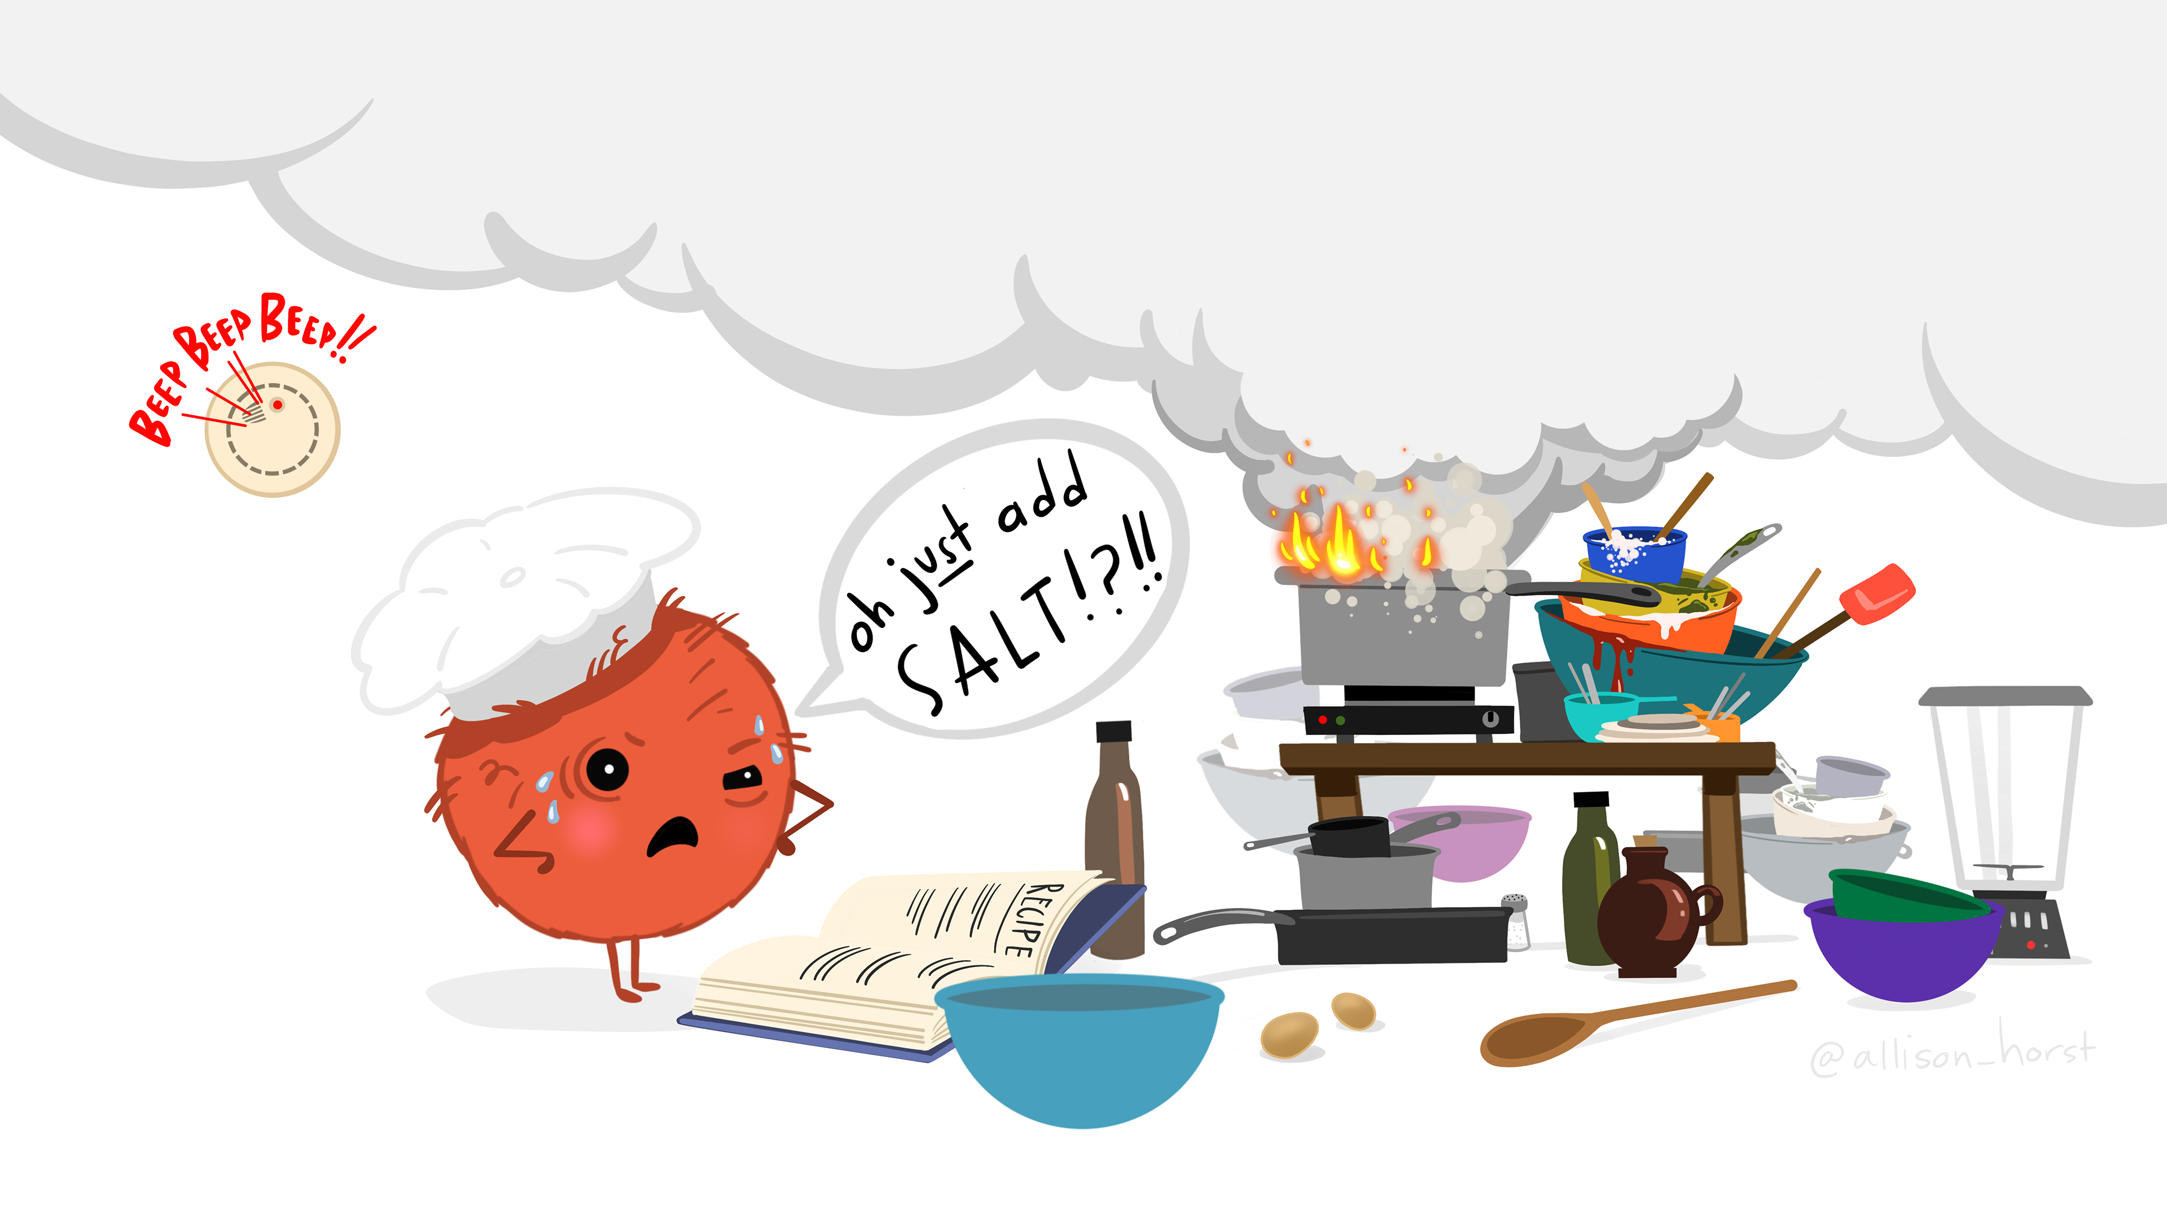
My initial R experience
Artwork by @allison_horst (CC BY 4.0)

Slide 7
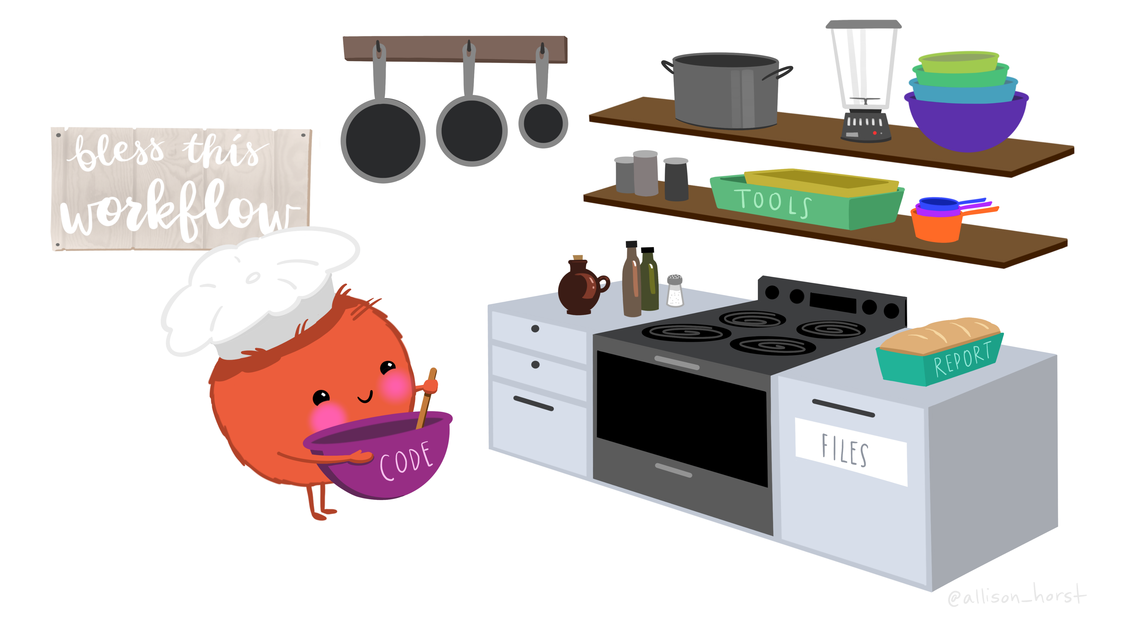
After some organization
Artwork by @allison_horst (CC BY 4.0)

Slide 8
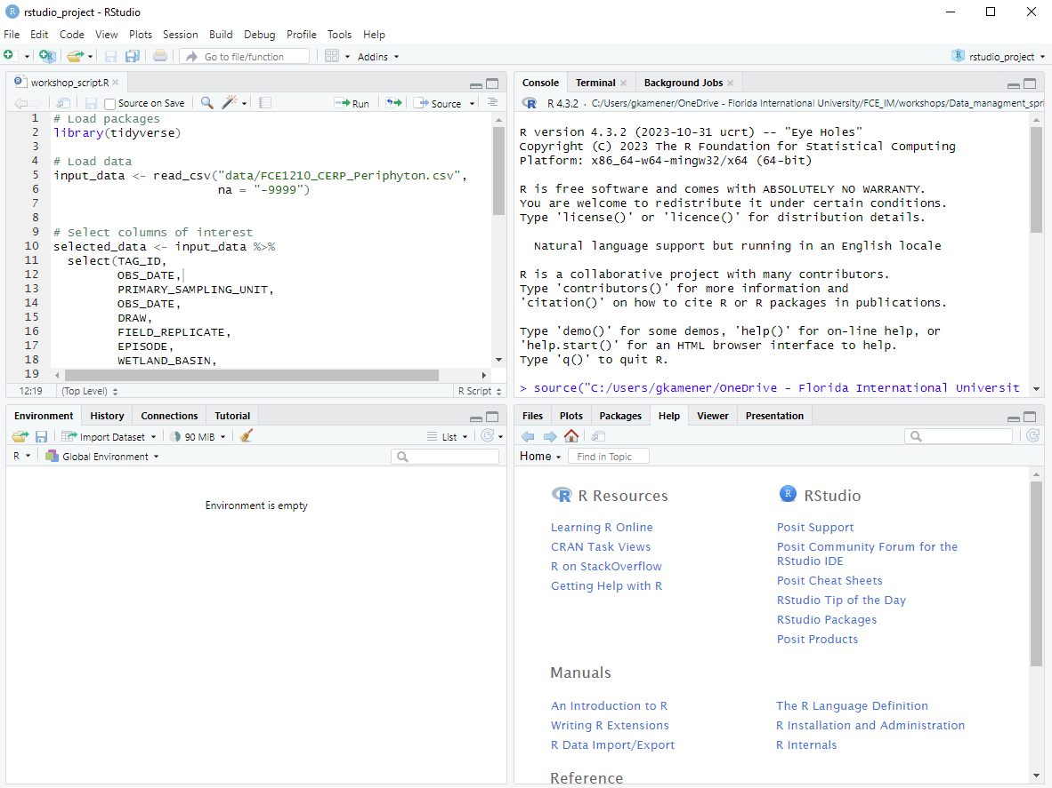
RStudio

Slide 9
RStudio Projects
Advantages of RStudio Projects:
Automatically set working directory
Portable
Share friendly
Can integrate with Git/GitHub
Can aid reproducibility with renv package

Slide 10
Setup an RStudio Project
Start RStudio.
Under the File menu, click on New Project. Choose New Directory, then New Project.
Enter a name for this new folder (or “directory”), and choose a convenient location for it. This will be your working directory for the rest of the day (e.g., ~/fce_data_workshop).
Click on Create Project.
Create folders for data (with “raw”, “intermediate”, and “final” subfolders), r scripts, and figures in your working directory.
Download code handout + data files and place into folders.
(Optional) Set Preferences to ‘Never’ save workspace in RStudio.

Slide 11
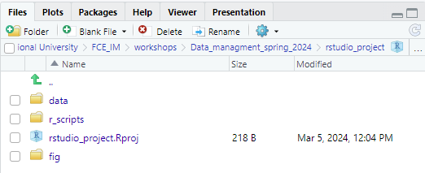
Organizing your working directory

Slide 12
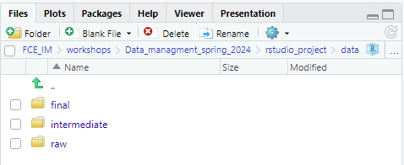
Organizing your working directory

Slide 13
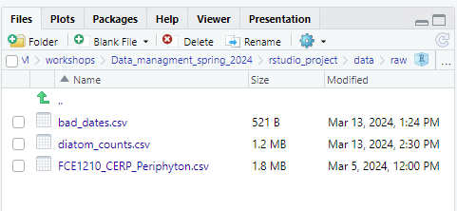
Organizing your working directory

Slide 14
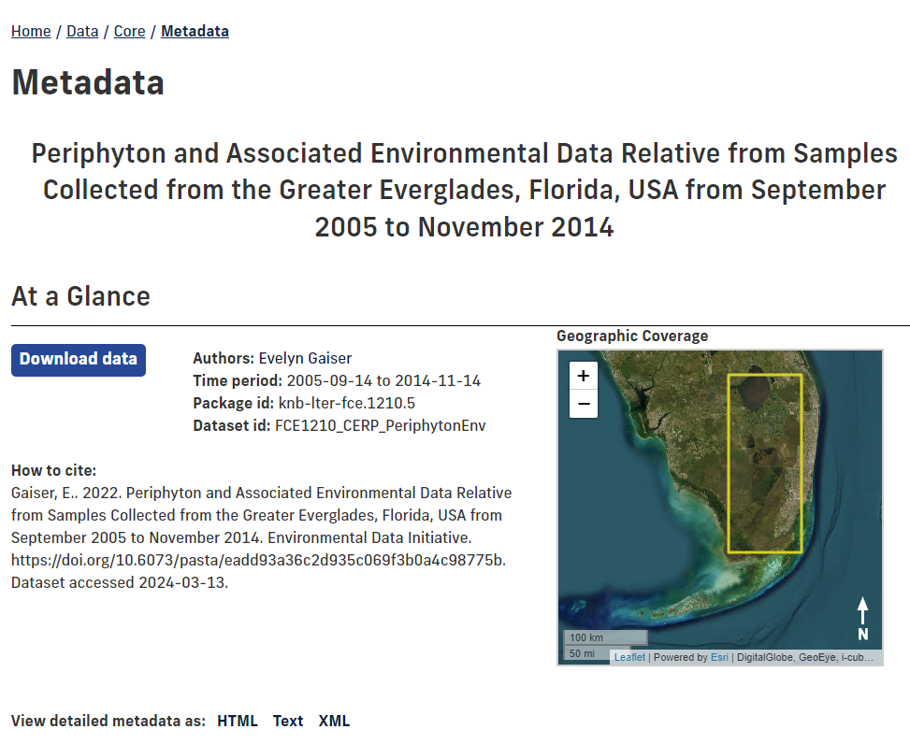
The data we are using today
https://fce-lter.fiu.edu/data/core/metadata/?packageid=knb-lter-fce.1210.5

Slide 15
Starting with data
Open code handout file
library(tidyverse)
peri_df <- read_csv("data/raw/FCE1210_CERP_Periphyton.csv",
na = "-9999")
diatoms_df <- read_csv("data/raw/diatom_counts.csv",
na = "NA")
bad_dates_df <- read_csv("data/raw/bad_dates.csv",
na = "-9999")

Slide 16
Indexing and subsetting data frames
Indexed by row, column
Can subset as data_frame[row_index, column_index]
Subset data frame
peri_df[1, 1]
peri_df[1, ]
peri_df[, 1]

Slide 17
Indexing and subsetting data frames
Subset multiple rows/columns
peri_df[c(1, 2, 3), c(5, 6)]
peri_df[1:3, 5:6]
Return vector instead with “[[ ]]”
peri_df[[1, 1]]

Slide 18
Indexing and subsetting data frames
Subset by column name
peri_df[1, "WATER_DEPTH_CM"]
Heads and tails
first_ten_rows <- head(peri_df, 10)
first_ten_rows
last_ten_rows <- tail(peri_df, 10)
view(last_ten_rows)

Slide 19
Factors
Useful for categorical variables
peri_df$FLOATING_SP1 <- factor(peri_df$FLOATING_SP1)
nlevels(peri_df$FLOATING_SP1)
levels(peri_df$FLOATING_SP1)

Slide 20
Formatting dates
my_date <- ymd("2015-01-01")
str(my_date)
my_date <- ymd(paste("2015", "1", "1", sep = "-"))
str(my_date)

Slide 21
Formatting dates
paste(bad_dates_df$YEAR, bad_dates_df$MONTH, bad_dates_df$DAY, sep = "-")
ymd(paste(bad_dates_df$YEAR, bad_dates_df$MONTH, bad_dates_df$DAY, sep = "-"))

Slide 22
Formatting dates
bad_dates_df$DATE <- ymd(paste(bad_dates_df$YEAR, bad_dates_df$MONTH, bad_dates_df$DAY, sep = "-"))
str(bad_dates_df)
summary(bad_dates_df$DATE)
missing_dates <- bad_dates_df[is.na(bad_dates_df$DATE), c("YEAR", "MONTH", "DAY")]
head(missing_dates)

Slide 23
Manipulating data
Select
Filter
Mutate
Pivot wider and longer
Group and summarize
Count
Exporting data

Slide 24
Select
selected_peri <- peri_df %>%
dplyr::select(TAG_ID,
OBS_DATE,
PRIMARY_SAMPLING_UNIT,
FIELD_REPLICATE,
EPISODE,
WETLAND_BASIN,
WATER_DEPTH_CM,
FLOATING_SP1,
PERI_AFDM_G_PER_M2,
PERI_TP_UG_PER_G_DRY_MASS,
PERI_PROP_ORGANIC
)

Slide 25
Filter
filtered_peri <- selected_peri %>%
filter(month(OBS_DATE) > 8)
filter_missing_peri_tp <- selected_peri %>%
filter(!is.na(PERI_TP_UG_PER_G_DRY_MASS))

Slide 26
Mutate
mutated_peri <- filtered_peri %>% mutate(peri_percent_organic = PERI_PROP_ORGANIC*100)
mutated_peri %>%
select(PERI_PROP_ORGANIC,
peri_percent_organic)

Slide 27
Pivot wider and longer
diatoms_counts_long <- diatoms_df %>%
pivot_longer(-c(TAG_ID:LSU_NAME),
values_to = "SPECIMENS_COUNTED",
names_to = "TAXON_CODE")
diatom_counts_wide <- diatoms_counts_long %>%
pivot_wider(names_from = "TAXON_CODE",
values_from = "SPECIMENS_COUNTED",
names_sort = TRUE,
values_fill = 0)

Slide 28
Group and summarize
summarized_water_depths <- filtered_peri %>%
group_by(WETLAND_BASIN,
YEAR = year(OBS_DATE)) %>%
summarize(mean_water_depth_cm = mean(WATER_DEPTH_CM))
summarized_water_depths
summarized_water_depths_wide <- summarized_water_depths %>%
pivot_wider(names_from = WETLAND_BASIN,
values_from = mean_water_depth_cm)
summarized_water_depths_wide

Slide 29
Group and summarize
diatoms_counts_filtered <- diatoms_counts_long %>%
filter(!is.na(SPECIMENS_COUNTED)
& SPECIMENS_COUNTED != 0)
total_diatoms <- diatoms_counts_long %>%
group_by(TAG_ID) %>%
summarize(TOTAL_COUNT = sum(SPECIMENS_COUNTED))
total_diatoms

Slide 30
Group and summarize
rel_abund <- diatoms_counts_filtered %>%
# Using dplyr's left_join function to join with the total_diatoms data frame
left_join(., total_diatoms, by = "TAG_ID") %>%
mutate(RELATIVE_PCT_ABUND = SPECIMENS_COUNTED/TOTAL_COUNT*100) %>%
select(TAG_ID,
OBS_DATE,
PRIMARY_SAMPLING_UNIT,
WETLAND_BASIN,
TAXON_CODE,
RELATIVE_PCT_ABUND
)
rel_abund

Slide 31
Count
filtered_peri %>%
count(FLOATING_SP1, sort = TRUE)
diatoms_counts_filtered %>%
count(TAXON_CODE, sort = TRUE)

Slide 32
Exporting data
write_csv(filtered_peri, "data/intermediate/filtered_peri.csv")
write_csv(summarized_water_depths_wide, "data/final/summarized_water_depths_wide.csv")

Slide 33
Activity: make your own variable
Organize your data
Mutate a new variable
Share that variable (including how you made it) with your neighbor

Slide 34
Visualizing data with ggplot
#ggplot(data = <DATA>, mapping = aes(<MAPPINGS>)) + <GEOM_FUNCTION>()
ggplot(data = filtered_peri)
ggplot(data = filtered_peri, mapping = aes(x = WATER_DEPTH_CM, y = PERI_AFDM_G_PER_M2))

Slide 35
Scatter plots
ggplot(data = filtered_peri, mapping = aes(x = WATER_DEPTH_CM, y = PERI_AFDM_G_PER_M2)) +
geom_point()

Slide 36
Boxplots
ggplot(data = filtered_peri, mapping = aes(x = WETLAND_BASIN, y = WATER_DEPTH_CM)) +
geom_boxplot()

Slide 37
Trend lines
ggplot(data = filtered_peri, mapping = aes(x = year(OBS_DATE), y = WATER_DEPTH_CM)) +
geom_line()
ggplot(data = summarized_water_depths, mapping = aes(x = YEAR, y = mean_water_depth_cm, color = WETLAND_BASIN)) +
geom_line() +
scale_x_continuous(breaks = c(2005:2014))

Slide 38
Stacked bar
rel_abund_2014_W3B <- rel_abund %>%
filter(year(OBS_DATE) == 2014
& WETLAND_BASIN == "W3B")
ggplot(rel_abund_2014_W3B,
aes(fill = TAXON_CODE,
y = RELATIVE_PCT_ABUND,
x = PRIMARY_SAMPLING_UNIT)) +
geom_bar(position="stack", stat="identity")

Slide 39
Customizing plots
ggplot(rel_abund_2014_W3B,
aes(fill = TAXON_CODE,
y = RELATIVE_PCT_ABUND,
x = PRIMARY_SAMPLING_UNIT)) +
geom_bar(position="stack", stat="identity") +
labs(title = "Relative % abundance at W3B sites in 2014",
x = "Primary Sampling Unit",
y = "Relative Percent Abundance",
fill = "Diatom taxon code") +
theme(axis.title.x = element_text(size = 11),
axis.title.y = element_text(size = 15))

Slide 40
Customizing plots
rel_abund_2014_w3b_cut <- rel_abund %>%
filter(year(OBS_DATE) == 2014
& WETLAND_BASIN == "W3B") %>%
mutate(TAXON_CODE = if_else(RELATIVE_PCT_ABUND < 2,
"OTHER",
TAXON_CODE)) %>%
group_by(PRIMARY_SAMPLING_UNIT,
TAXON_CODE) %>%
summarize(RELATIVE_PCT_ABUND = sum(RELATIVE_PCT_ABUND))

Slide 41
Customizing plots
plot_2014_w3b_cut <- ggplot(rel_abund_2014_w3b_cut,
aes(fill = TAXON_CODE,
y = RELATIVE_PCT_ABUND,
x = PRIMARY_SAMPLING_UNIT)) +
geom_bar(position="stack", stat="identity") +
labs(title = "Relative % abundance at W3B sites in 2014",
x = "Primary Sampling Unit",
y = "Relative Percent Abundance",
fill = "Diatom taxon code") +
theme(plot.title = element_text(size = 15),
axis.title.x = element_text(size = 12),
axis.title.y = element_text(size = 12))

Slide 42
Customizing plots
plot_2014_w3b_cut

Slide 43
Saving plots
ggsave("fig/W3B_2014_relative_abundance.png",
plot = plot_2014_w3b_cut)
ggsave("fig/W3B_2014_relative_abundance_custom_size.png",
plot = plot_2014_w3b_cut,
width = 46,
height = 26,
units = "cm",
limitsize = FALSE)

Slide 44
Make your own plot
Make your own plot
Share it with your neighbor (including how you made it)

Slide 45
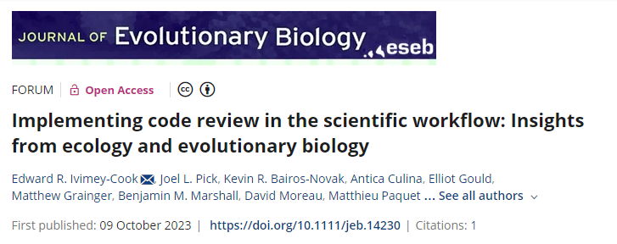
Code organization and review
https://doi.org/10.1111/jeb.14230

Slide 46
Potential code issues
Reading in data files with paths outside project
Order of workflow is unclear
Comments say “go right” but code goes left
Code fails to run on another computer
Code fails or outputs change after updating R or packages
Results not reproducible for manuscript reviewer
Notes:
Ecology Letters now requires accessible codes for review at time of submission: https://onlinelibrary.wiley.com/page/journal/14610248/homepage/forauthors.html#data-availability

Slide 47
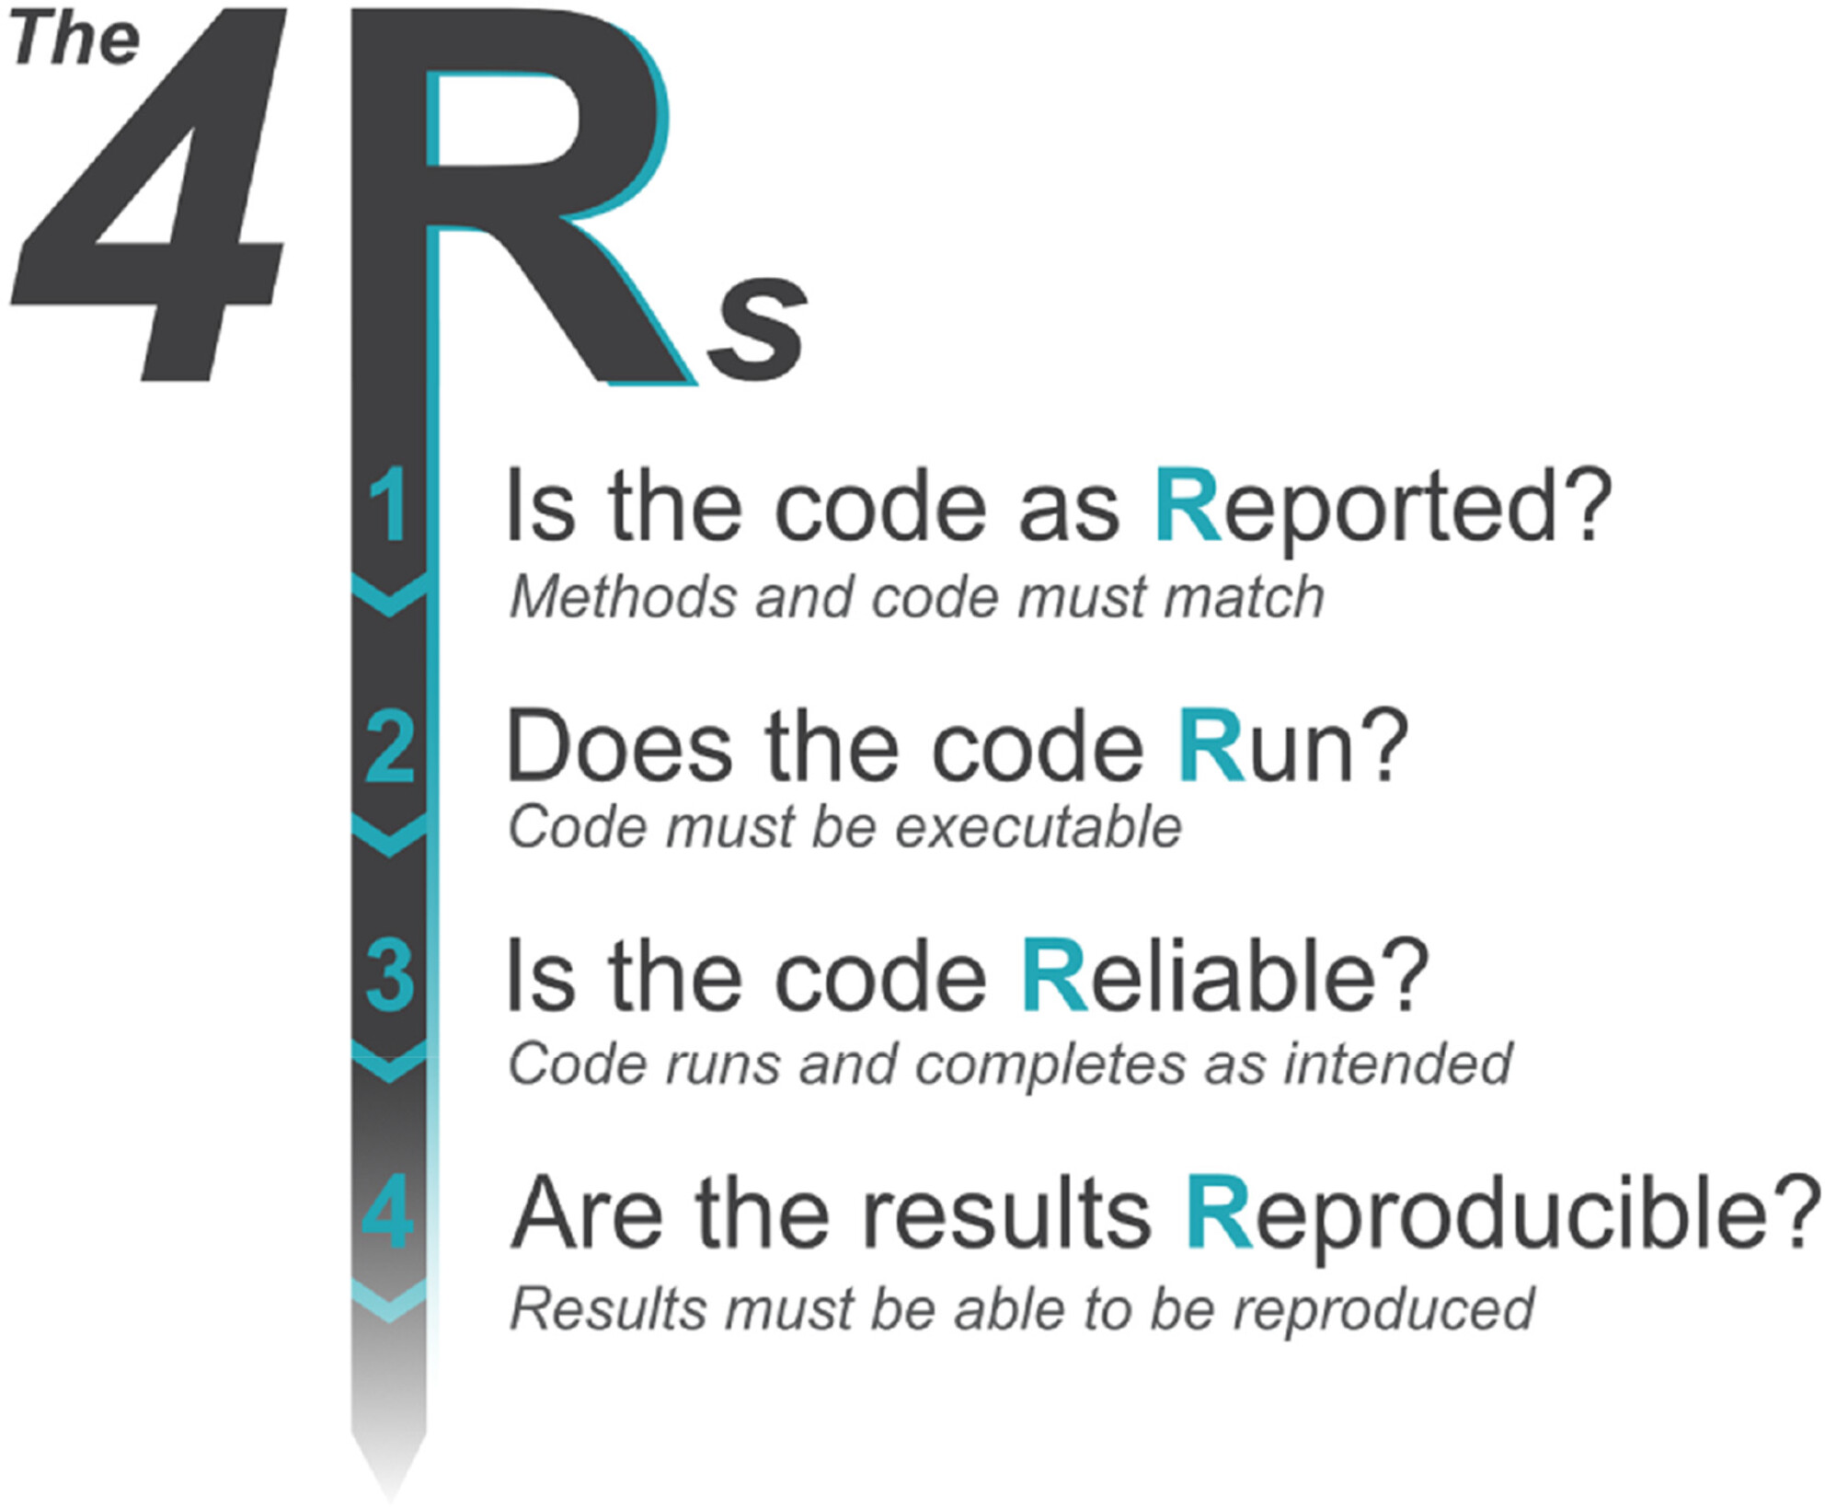
The four ‘Rs’ of code review
J of Evolutionary Biology, Volume: 36, Issue: 10, Pages: 1347-1356, First published: 09 October 2023, DOI: (10.1111/jeb.14230)

Slide 48
Is the code as Reported?
Are analyses as described in manuscript?
Are relevant packages (with version numbers) documented in manuscript?

Slide 49
Does the code Run?
library(tidyverse) Error in library(tidyverse): there is no package called ‘tidyverse’.
install.packages("tRophicPosition") Warning in install.packages : package ‘tRophicPosition’ is not available for this version of R
Misspelled code

Slide 50
Is the code Reliable?
#remove MC28 duplicate empty stomach stomachs.raw <- stomachs.raw[-c(4),]
May run but removes different row than described

Slide 51
Are the results Reproducible?
Do reproduced results match those reported?
If they differ, by how much?
Is an observed difference reasonable to expect?

Slide 52
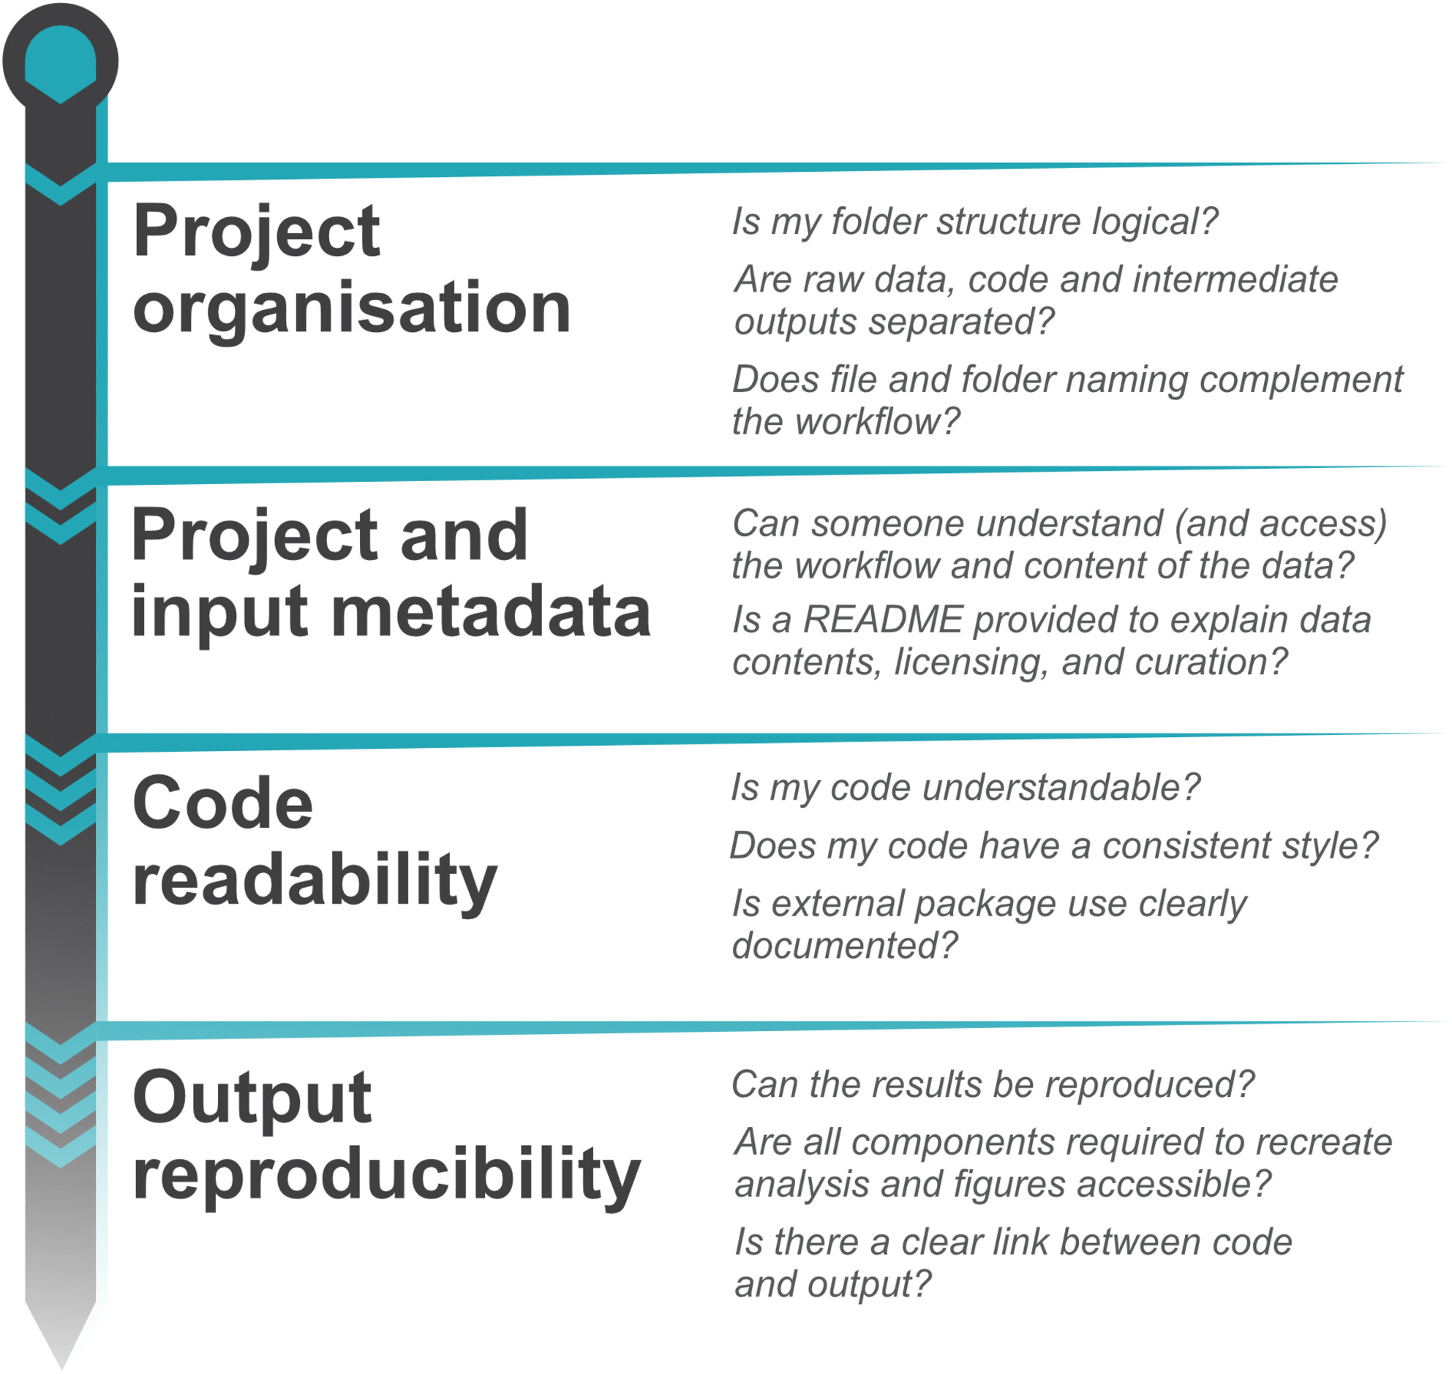
Where code fits into the workflow
J of Evolutionary Biology, Volume: 36, Issue: 10, Pages: 1347-1356, First published: 09 October 2023, DOI: (10.1111/jeb.14230)

Slide 53
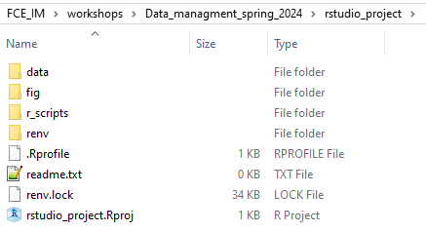
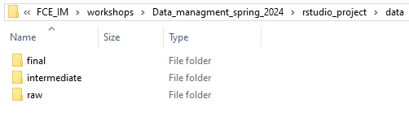
Project organization: data

Slide 54
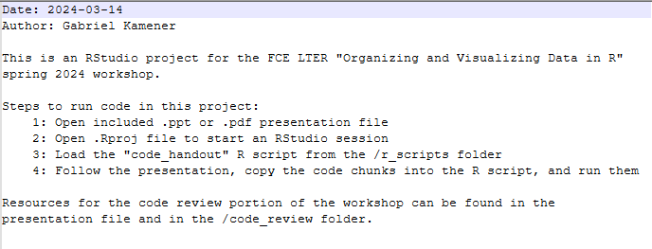
Project and input metadata: README

Slide 55
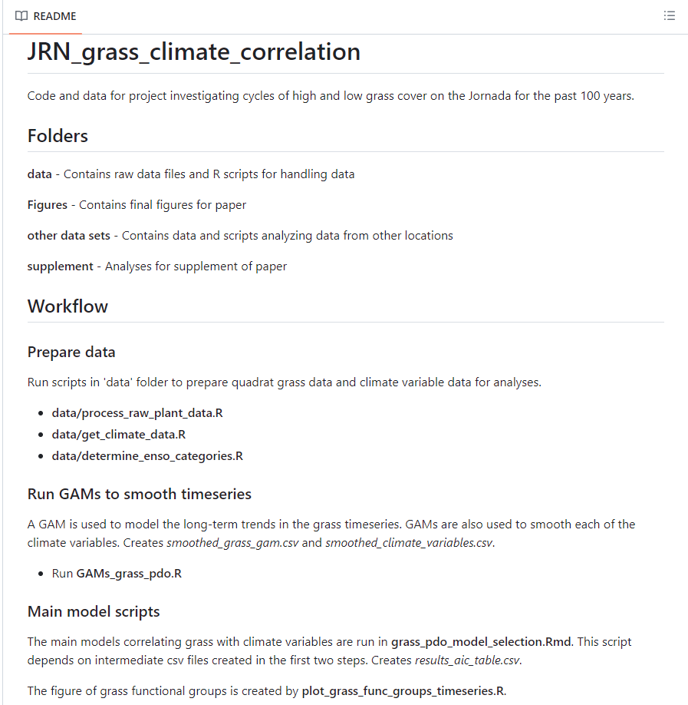
Project and input metadata: README
Can scale in complexity
Christensen, E. 2023. https://github.com/emchristensen/JRN_grass_climate_correlation

Slide 56
Code readability
Explicitly calling package namespace (e.g. dplyr::select())
Using relative file paths
Removing redundant packages
Writing code with
Clear subheadings
Intuitive comments
Easy-to-understand object names

Slide 57
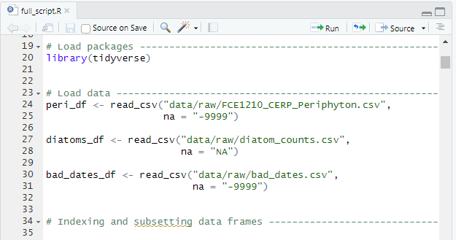
Code readability: code sections
Break code down by region
Comment line with at least 4 trailing “-”, “=“, or “#”
Code -> Insert Section
Crtl+Shift+R

Slide 58
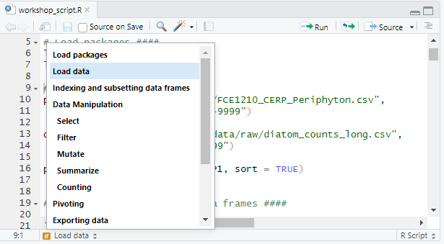
Code readability: navigating sections

Slide 59
Output reproducibility
Link between code sections and published outputs should be clear
Use set.seed() before running simulations
Increase reproducibility of environment with renv package

Slide 60
Generating citations
R version citation: citation()
Package version: citation("dplyr")
RStudio.Version()

Slide 61
Other suggestions
Keep primary R scripts for yourself
Include all analyses and comments
Distill down code for manuscript submission
Only relevant analyses and comments
Use version control (e.g. Git/GitHub) to track changes
Code sections to cover each dependent variable
Form code review group in your lab or with other students

Slide 62
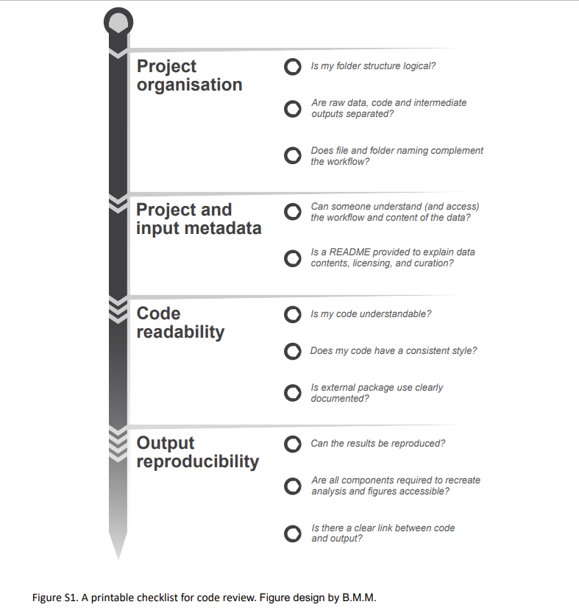
Project code checklist
J of Evolutionary Biology, Volume: 36, Issue: 10, Pages: 1347-1356, First published: 09 October 2023, DOI: (10.1111/jeb.14230)

Slide 63
Activity: Project and Code Development
Use the checklist to review your own project and code
Work with your neighbor to review each other’s code or the provided example code

Slide 64
Constructive feedback
How much of this did you know?
How much did you not know?
What would you like us to include or exclude in the future?

Slide 65
References and resources
Christensen, E. 2023. “Emchristensen/JRN_Grass_Climate_Correlation: ARIMA Models.” Zenodo. https://doi.org/10.5281/zenodo.7787243.
Ivimey‐Cook, E. R., Pick, J. L., Bairos‐Novak, K. R., Culina, A., Gould, E., Grainger, M., ... & Windecker, S. M. (2023). Implementing code review in the scientific workflow: Insights from ecology and evolutionary biology. Journal of evolutionary biology, 36(10), 1347-1356. https://doi.org/10.1111/jeb.14230
Brian Seok, François Michonneau, Tobias Busch, Katrin Leinweber, Maneesha Sane, njlyon0, Ed Bennett, Hugo Tavares, Mike Mahoney, Paula Nieto, Susan Washko, Terry Loecke, Wasila Dahdul, xli677, Abhijna Parigi, Aleksander Jankowski, Allison Shay Theobold, Analytics Enlightened LLC, Anna K. Moeller, … vmzhang. (2023). datacarpentry/R-ecology-lesson: Data Carpentry: Data Analysis and Visualization in R for Ecologists 2023-05 (2023.05). Zenodo. https://doi.org/10.5281/zenodo.7892261

Slide 66
References and resources
Data Analysis and Visualization in R for Ecologists workshop website
https://datacarpentry.org/R-ecology-lesson/
R cheatsheets (also findable as PDFs from Rstudio “help” tab)
https://rstudio.github.io/cheatsheets/
Code Folding and Sections in the RStudio IDE
https://support.posit.co/hc/en-us/articles/200484568-Code-Folding-and-Sections-in-the-RStudio-IDE
How to Cite R and R Packages
https://ropensci.org/blog/2021/11/16/how-to-cite-r-and-r-packages/
Introduction to renv to help create reproducible environments for R projects
https://rstudio.github.io/renv/articles/renv.html

